Slide 1
Chapter 10
Trees
Notes:
- A connected graph that contains no simple circuits is called a tree. Trees are particularly useful in computer science, where they are employed in a wide range of algorithms.

Slide 2
Objectives
10.1- Introduction to Trees
10.2- Applications of Trees
10.3- Tree Traversal

Slide 3
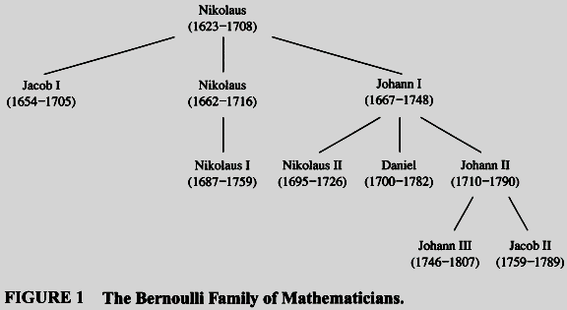
10.1- Introduction to Trees

Slide 4
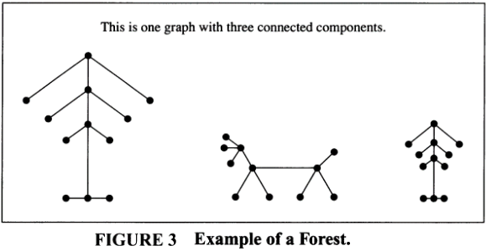
Introduction to Trees…

Slide 5
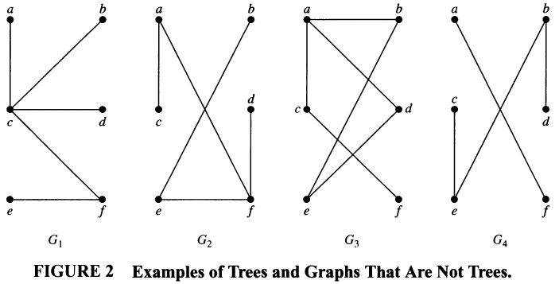
Introduction to Trees
circuit
disconnected

Slide 6


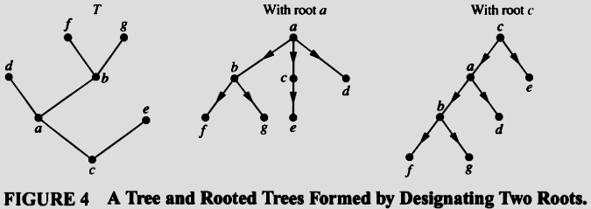
Introduction to Trees…
Proof: page 684
Notes:
- Trees are often defined as undirected graphs with the property that there is a unique simple path between every pair of vertices. Theorem I shows that this alternative definition is equivalent to our definition.

Slide 7
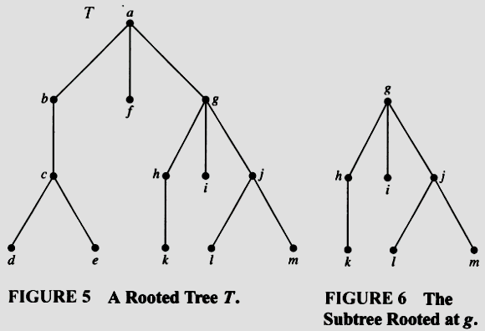
Introduction to Trees…
Some terminologies:
Subtree
Root node (vertex)
Internal node
Leaf
Parent
Child
Siblings
Descendants
Ancestors
Page 686

Slide 8
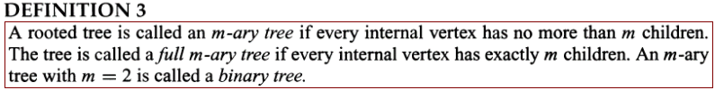
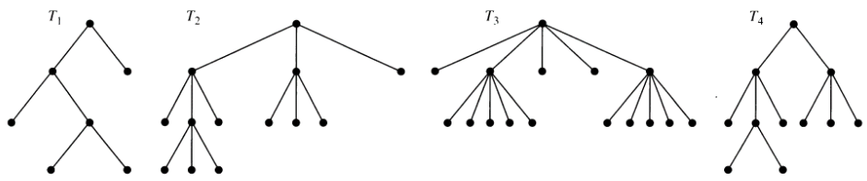
Introduction to Trees…
Full
Binary
Full
Ternary
Full
5-ary
3-ary
Some terminologies on binary tree:
Left child, right child, left subtree, right subtree

Slide 9
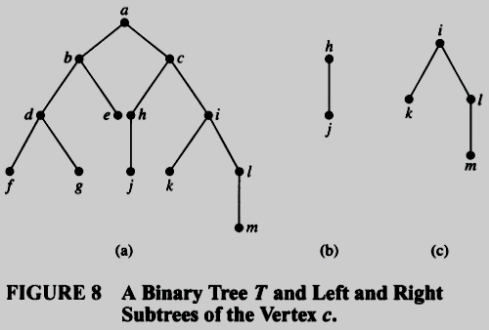
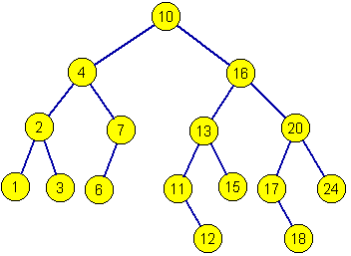
Introduction to Trees…
Ordered rooted tree
Notes:
An ordered rooted tree is a rooted tree where the children of each internal vertex are ordered. Ordered rooted trees are drawn so that the children of each internal vertex are shown in order from left to right.
In a binary tree, if a vertex has two children, the first child is called the left child and the second child is called the right child.
The tree rooted at the left child of a vertex is called the left subtree of this vertex, and the tree rooted at the right child of a vertex is called the right subtree of the vertex.

Slide 10
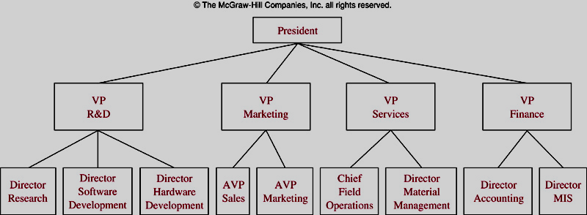
Some Tree Models
A Organizational Tree
Notes:
The structure of a large organization can be modeled using a rooted tree.
Vertices are positions in the organization.
An edge from one vertex to another indicates that the person represented by the initial vertex is the (direct) boss of the person represented by the terminal vertex.

Slide 11
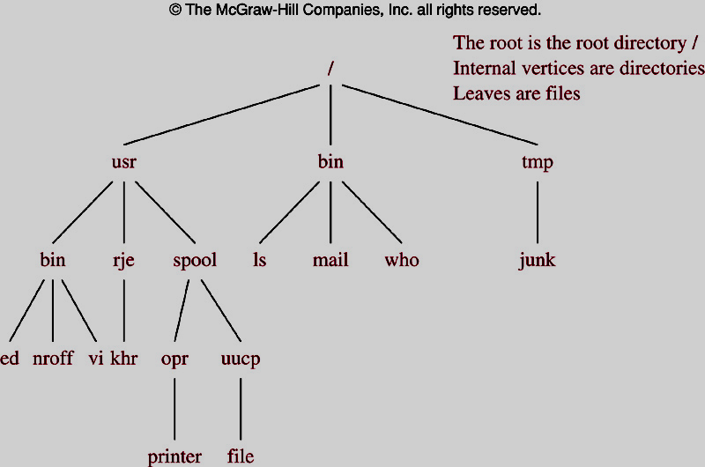
Some Tree Models
A Computer File System
Notes:
-

Slide 12
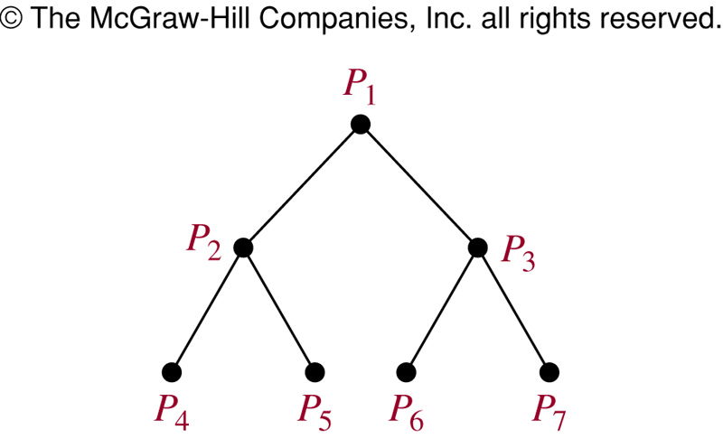
Some Tree Models
A Tree-connected Network of seven Processors
Notes:
- For computing x₁ + x₂ + x₃ + x₄ + x₅ + x₆ + x₇ +x₈ in a parallel computation.
Adding x₁ and x₂ by using P₄, x₃ and x₄ using P₅, x₅ and x₆ using P₆, x₇ and x₈ using P₈.
Adding x₁+x₂ and x₃+x₄ using P₂, x₅ + x₆ and x₇ + x₈ using P₃
Adding x₁ + x₂ + x₃ + x₄ and x₅+x₆+x₇+x₈ using P₁.

Slide 13

Properties of Trees
Using Mathematic Induction.
Let nE be number of edges.
P(n): If the tree T having n vertices then nE=n-1
Basic step:
P(1): n=1, tree has the root node only → nE= 0 = n-1 → P(1) true
Induction step:
Suppose that P(k) is true for all k>=1, ie nE=k-1
Add a leaf vertex v to the tree T so that T having k+1 verteices still is a tree.
Let w be the parent of v.
Because T is connected and has no simple circuit → there is only one new edge between u and v → nE= (k-1)+1 = k .
→ P(k+1) true
Proved.

Slide 14
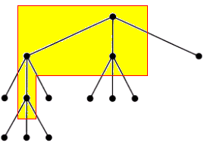
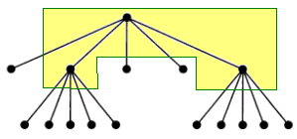
Introduction to Trees…
m=3
i=4
n= 3.4+1=13
m=5
i=3
n= 3.5+1=16
Notes:
n: number of nodes in a full m-ary tree
i: number of internal nodes in a full m-ary tree

Slide 15
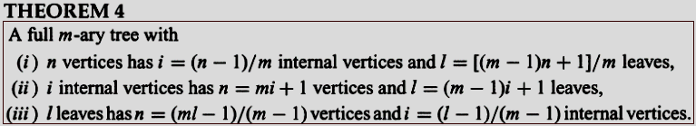
Introduction to Trees…
m=3
n=13
i=12/3= 4
l= [(3-1)13+1]/3=9
m=5
n=16
i= 15/5=3
l= (4.16+1)/5= 13
Notes:
l: number of leaves in a full m-ary tree

Slide 16
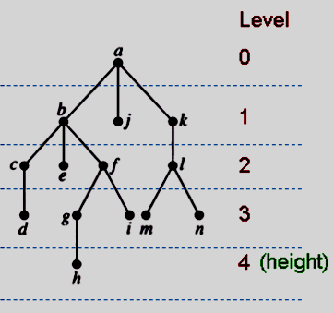
Introduction to Trees…
Level of a vertex: The length of the path from the root to this vertex.
Height of Tree: The maximum of levels of vertices = The length of the longest path from the root to any vertex.
Notes:
Note that there exists a rooted tree of height 0.
The height of a rooted tree is the length of the longest path from the root to any vertex.

Slide 17
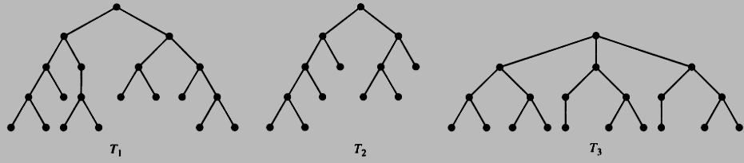
Introduction to Trees…
A m-ary tree is called balanced if all leaves are at levels h or h-1.
h=4
All leafs are at levels 3, 4
→ Balanced
h=4
All leafs are at levels 2,3, 4
→ Not Balanced
h=3
All leafs are at levels 3
→ Balanced

Slide 18
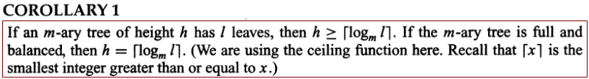
Introduction to Trees…
THEOREM 5: (Proof: page 692)
There are at most m^{h} leaves in an m-ary tree of height h.
Proof: page 693

Slide 19
10.2- Applications of Trees
Binary Search Trees
Decision Trees
Prefix Codes
Notes:
We will discuss three problems that can be studied using trees.
The first problem is: How should items in a list be stored so that an item can be easily located?
The second problem is: What series of decisions should be made to find an object with a certain property in a collection of objects of a certain type?
The third problem is: How should a set of characters be efficiently coded by bit strings?

Slide 20
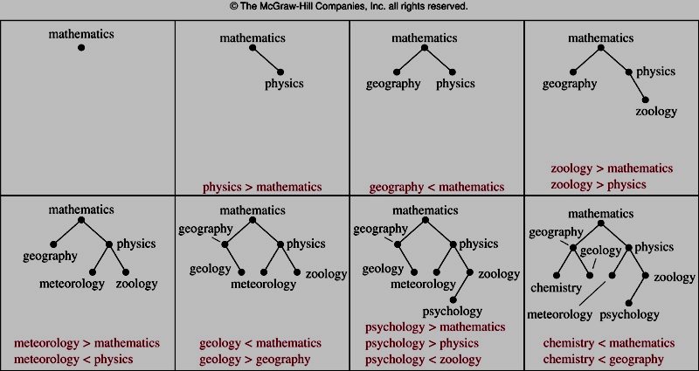
Constructing a Binary Search Tree
Construct a binary search tree for numbers: 23, 16, 43, 5, 9, 1, 6, 2, 33, 27.
Notes:
- In a binary search tree, vertices are assigned keys so that the key of a vertex is both larger than the keys of all vertices in its left subtree and smaller than the keys of all vertices in its right subtree.

Slide 21
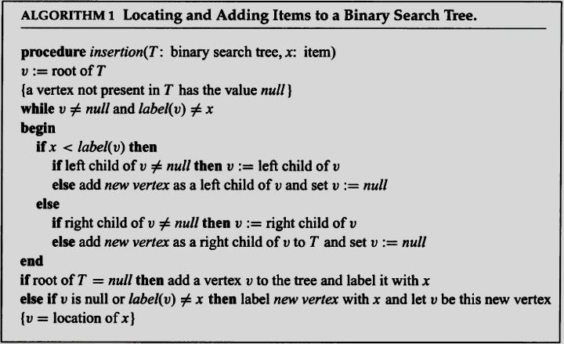
Algorithm for inserting an element to BST
Complexity: O(logn)
Proof: page 698
Notes:
v is the vertex currently under examination and label(v) represents the key of this vertex.
The algorithm begins by examining the root. If the x equals the key of v, then the algorithm has found the location of x and terminate s; if x is less than the key of v, we move to the left child of v and repeat the procedure; and if x is greater than the key of v, we move to the right child of v and repeat the procedure.
If at any step we attempt to move to a child that is not present, we know that x is not present in the tree, and we add a new vertex as this child with x as its key.

Slide 22
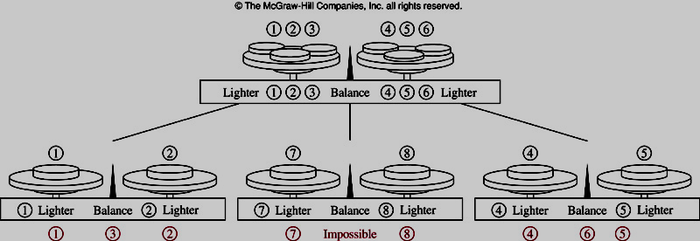
Decision Trees
The Counterfeit Coin Problem
Notes:
Rooted trees can be used to model problems in which a series of decisions leads to a solution. For example, suppose there are seven coins, all with the same weight, and a counterfeit coin that weighs less than the others. How many weighings are necessary using a balance scale to determine which of the eight coins is the counterfeit one?
It is possible to determine the counterfeit coin using two weighings. The decision tree that illustrates how this is done is shown in the given Figure.

Slide 23
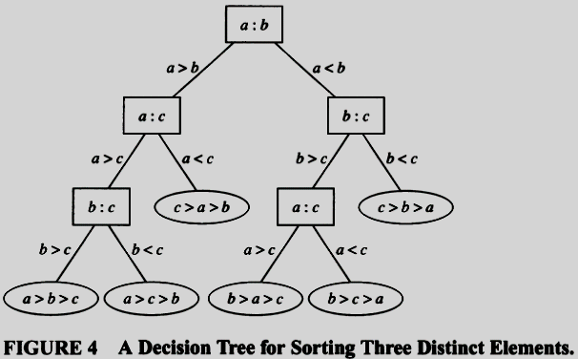
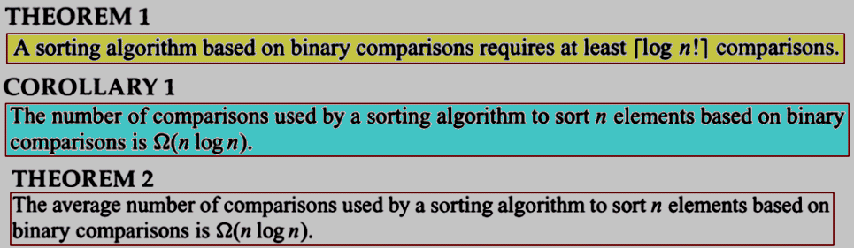
Decision Trees:
Sorting based on Binary Comparisons
Notes:
A sorting algorithm based on binary comparisons can be represented by a binary decision tree.
Each leaf represents one of the n! permutations of n elements.
Each internal vertex represents a comparison of two elements.

Slide 24
Prefix Codes
Introduction to Prefix Codes
Huffman Coding Algorithm

Slide 25
Prefix Codes: Introduction
English word “sane” is stores 1 byte/character ➔ 4-byte memory block is needed (32 bits).
There are 26 characters → We can use 5 bit only to store a character ( 2⁵=32)
The word “sane” can be stored in 20 bits
May we can store this word in fewer bit?
Notes:
- Consider the problem of using bit strings to encode the letters of the English alphabet.

Slide 26
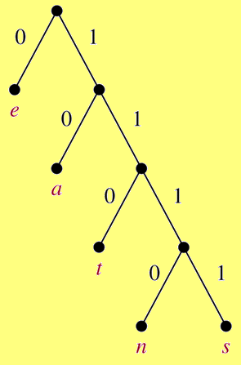
Prefix Codes: Introduction
Construct a binary tree with a prefix code.
“sane” will be store as
11111011100 ➔ 11 bits
11111011100 : s
11111011100 : a
11111011100 : n
11111011100 : e
Compression factor: 32/11 ~ 3
Notes:
Codes with property that the bit string for a letter never occurs as the first part of the bit string for another letter are called prefix codes.

Slide 27
Prefix Codes: Huffman Coding Algorithm
Counting occurrences of characters in a text ➔ frequencies (probabilities) of each character.
Constructing a binary tree representing prefix codes of characters.
The set of binary codes representing each character.
Coding source text
Notes:
- Note that this algorithm assumes that we can compute the frequency of each symbol by dividing the number of times this symbol occurs
by the length of the string.
- Huffman coding is a fundamental algorithm in data compression, the subject devoted to reducing the number of bits required to represent information. Huffman coding is extensively used to compress bit strings representing text and it also plays an important role in compressing audio and image files.

Slide 28
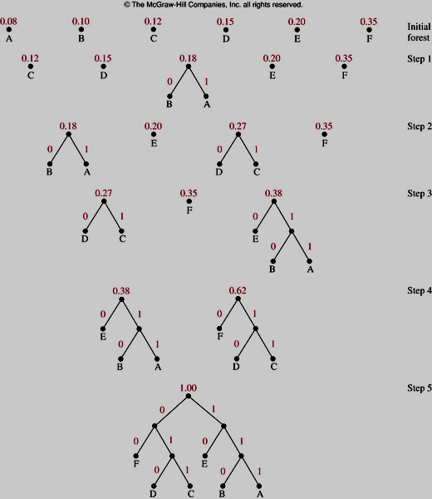
Prefix Codes: Huffman Coding Algorithm
Notes:
At each step, we combine two trees having the least total weight into a single tree by introducing a new root and placing the tree with larger weight as its left subtree and the tree with smaller weight as its right subtree.
We assign the sum of the weights of the two subtrees of this tree as the total weight of the tree.
When the forest is reduced to a single tree → stop.

Slide 29
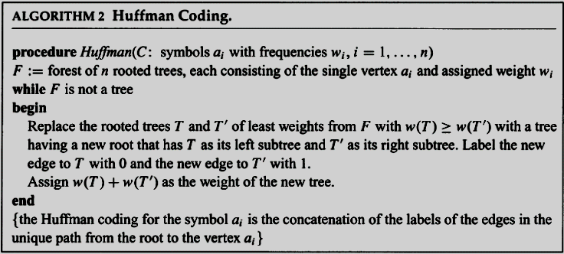
Prefix Codes: Huffman Coding Algorithm

Slide 30
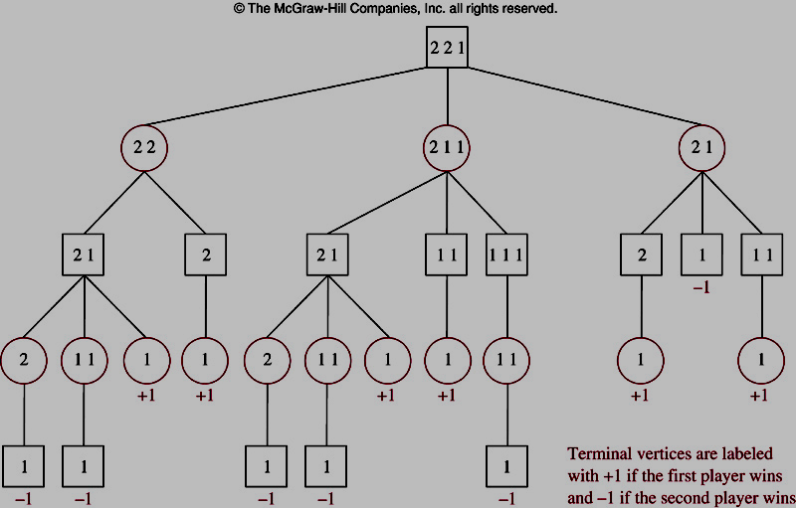
Game Trees: The Game Nim
There are some piles of stones ( ex: 2,2,1).
Two players will take turns picking stones from one pile.
The player picks the last stones is loser.
Notes:
- Trees can be used to analyze certain types of games such as tic-tac-toe, nim, checkers, and chess. In each of these games, two players take turns making moves. Each player knows the moves made by the other player and no element of chance enters into the game.

Slide 31
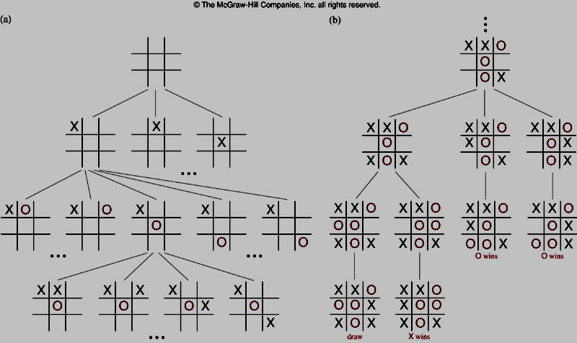
Game Trees : Tic-tac-toe
Notes:
The game tree for tie-tac-toe is extremely large and cannot be drawn here, although a computer could easily build such a tree. We show a portion of the game tic-tac-toe in Figure 8(a).
We also show a subtree of this game tree leading to terminal positions in Figure 8(b) , where a player who can win makes a winning move.

Slide 32
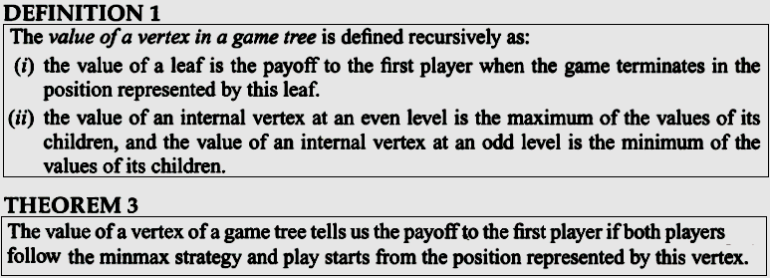
Game Trees…
Notes:
- We can determine who will win the game when both players follow the minmax strategy by calculating the value of the root of the tree; this value is called the value of the tree.

Slide 33
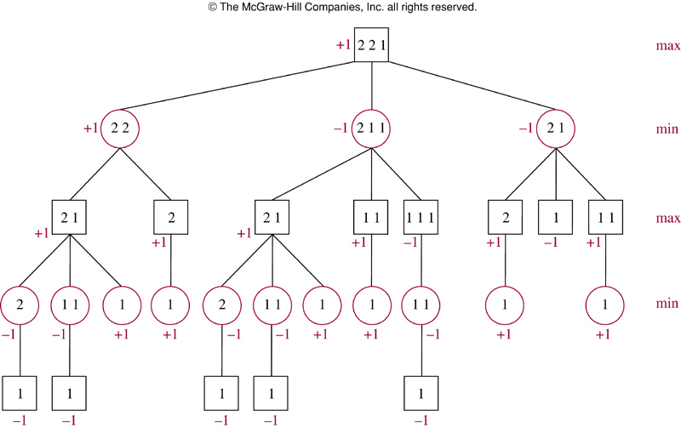

Game Trees…
Notes:
The value of the root is 1, it follows that the first player wins when both players follow a minmax strategy.

Slide 34
Traversal Algorithms
At a time, a vertex is visited
Operations are done:
  Process the visited vertex, e.g. list it’s information
  Traversing recursively subtree.
Bases on orders of tasks, traversals are classified into:
  Preorder traversal. N L R
  Inorder traversal. L N R
  Postorder traversal. L R N
Notes:
- Ordered rooted trees are often used to store information. We need procedures for visiting each vertex of an ordered rooted tree to access data. We will describe several important algorithms for visiting all the vertices of an ordered rooted tree.

Slide 35
10.3- Tree Traversal
Traversal a tree: A way to visit all vertices of the rooted tree.
  Universal Address Systems
  Traversal Algorithms
  Infix, Prefix, and Postfix Notation

Slide 36
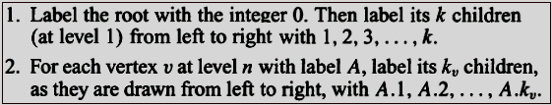
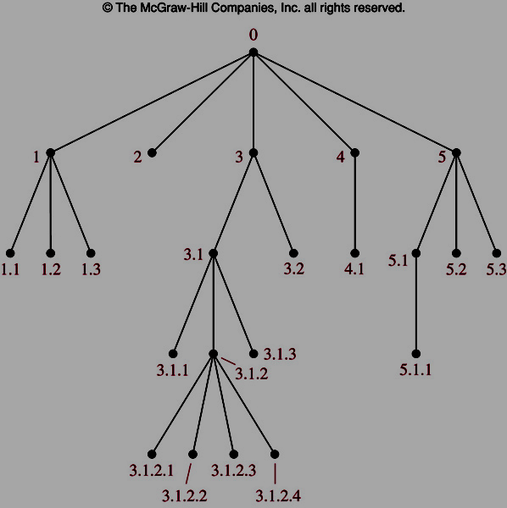
Universal Address Systems
Notes:
Procedures for traversing all vertices of an ordered rooted tree rely on the orderings of children. In ordered rooted trees, the children of an internal vertex are shown from left to right in the drawings representing these directed graphs.
By a recursive way we can totally order the vertices of an ordered rooted tree.

Slide 37
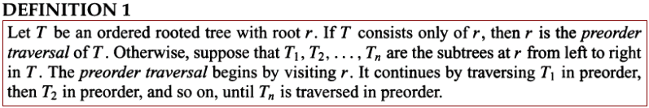
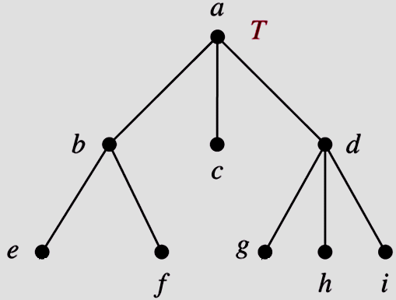
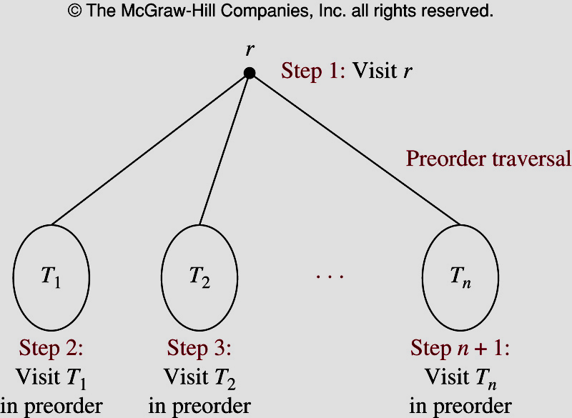
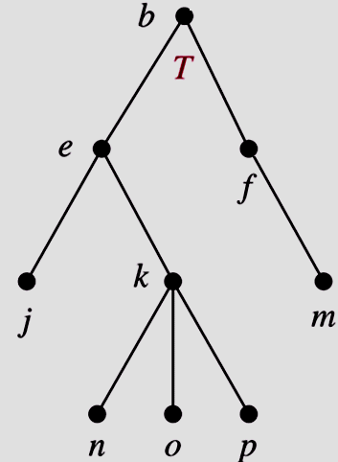
Preorder Traversal
a, b, e, f, c, d, g, h, i
?

Slide 38
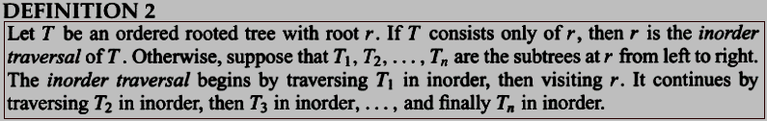
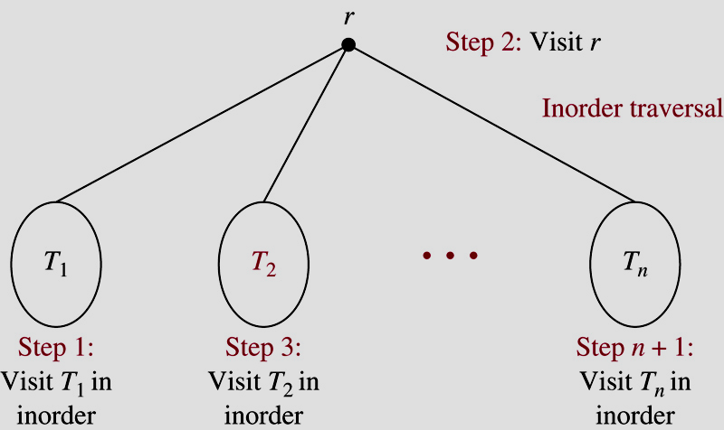
Inorder Traversal
e, b, f, a, c, g, d, h, i
?

Slide 39
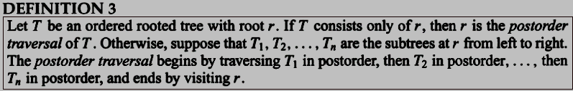
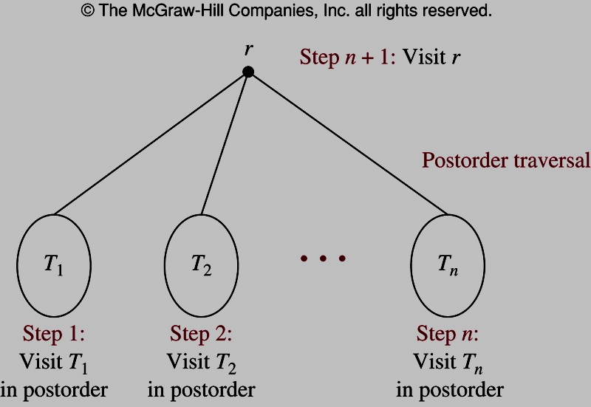
Postorder Traversal
e, f, b, c, g, h, i, d, a
?

Slide 40
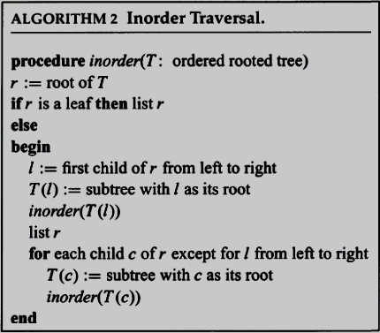
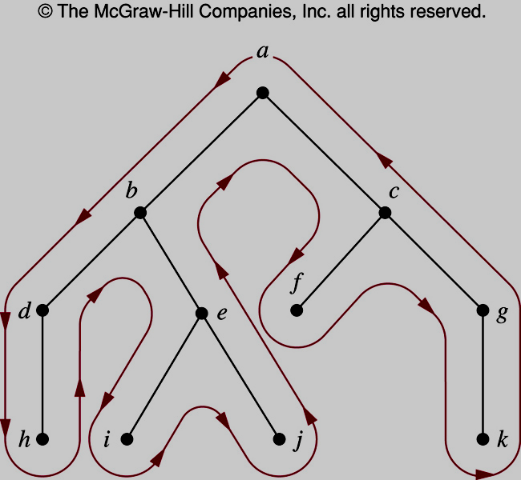
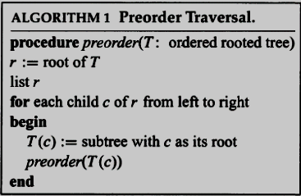
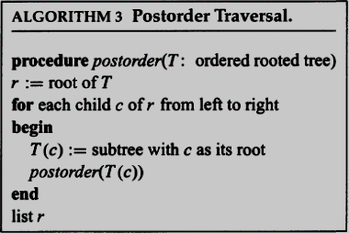
Traverse Algorithms
Notes:
- Note that both the preorder traversal and the postorder traversal encode the structure of an ordered rooted tree when the number of children of each vertex is specified. That is, an ordered rooted tree is uniquely determined when we specify a list of vertices generated by a preorder traversal or by a postorder traversal of the tree

Slide 41
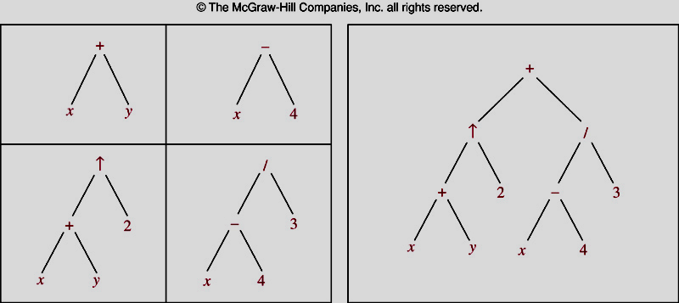
Infix, Prefix, and Postfix Notation
Expression Trees
Notes:
We can represent complicated expressions, such as compound propositions, combinations of sets, and arithmetic expressions using ordered rooted trees.
+ represents addition, - represents subtraction, * represents multiplication, / represents division and  represents exponentiation

Slide 42
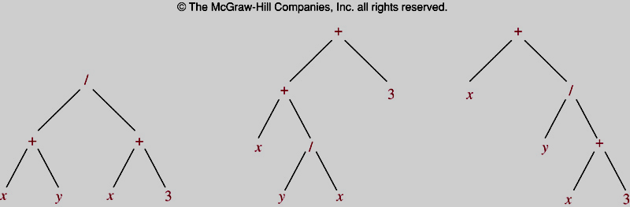
Infix, Prefix, and Postfix Notation
Expression Trees
Notes:
Inorder traversals of the binary trees in Figure 11, which represent the expressions (x + y)/(x + 3), (x + (y/x))+ 3, and x + (y/(x + 3)), all lead to the infix expression x + y/x + 3.
To make such expressions unambiguous it is necessary to include parentheses in the inorder traversal whenever we encounter an operation.

Slide 43
Infix, Prefix, and Postfix Notation
Infix form:
  operand_1 operator operand_2 x + y
Prefix form:
  operator(operand_1,operand_2) + x y
Postfix form:
  (operand_1,operand_2)operator x y +
How to find prefix and postfix form from infix form?
  (1) Draw expression tree.
  (2) Using Preorder traverse → Prefix form
  Using Postorder traverse → Postfix form

Slide 44
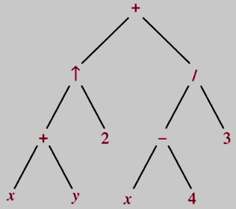

Infix, Prefix, and Postfix Notation
Infix form
Prefix form
Postfix form

Slide 45
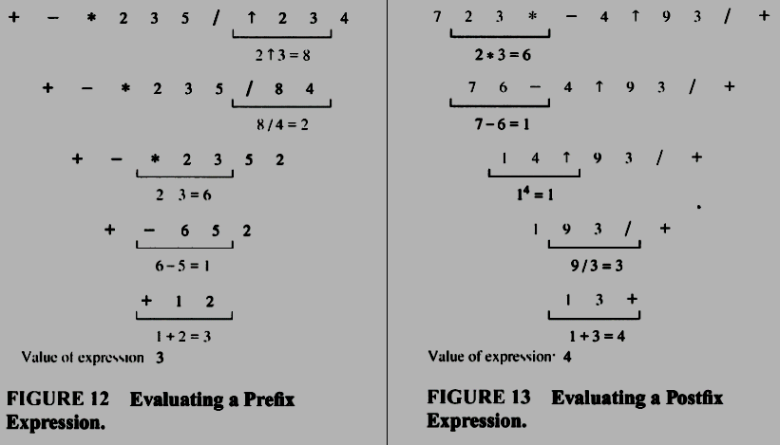
Infix, Prefix, and Postfix Notation
Notes:
Find the value of the value of the prefix expression + - * 2 3 5 /  2 3 4?

Slide 46
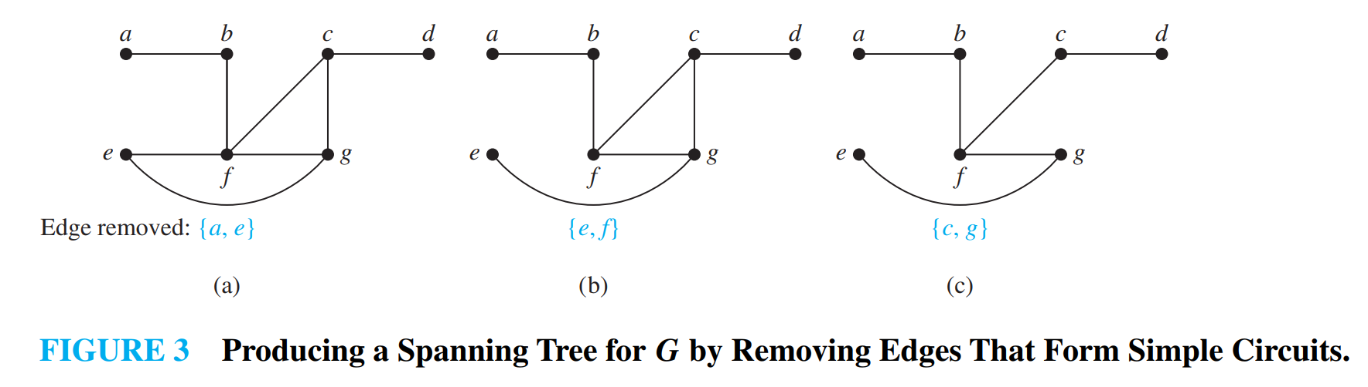
10.4- Spanning Trees
DEFINITION 1: Let G be a simple graph. A spanning tree of G is a subgraph of G that is a tree containing every vertex of G

Slide 47
10.4- Spanning Trees
THEOREM 1 : A simple graph is connected if and only if it has a spanning tree.

Slide 48
Summary
10.1- Introduction to Trees
10.2- Applications of Trees
10.3- Tree Traversal

Slide 49
Thanks

